Slide 1
Ratio Analysis

Slide 2
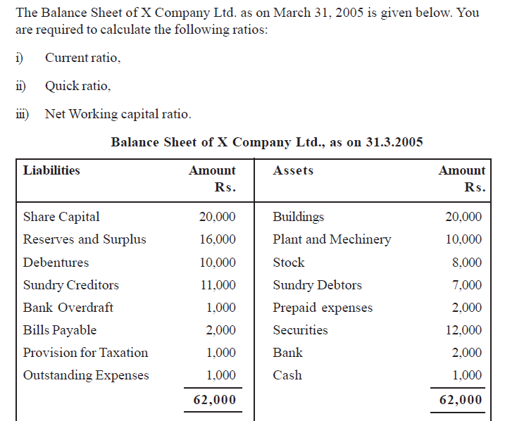

Slide 3
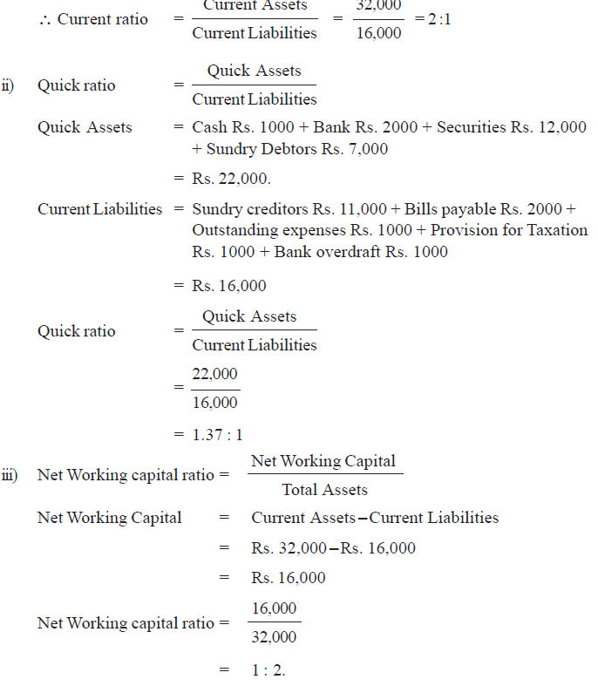

Slide 4
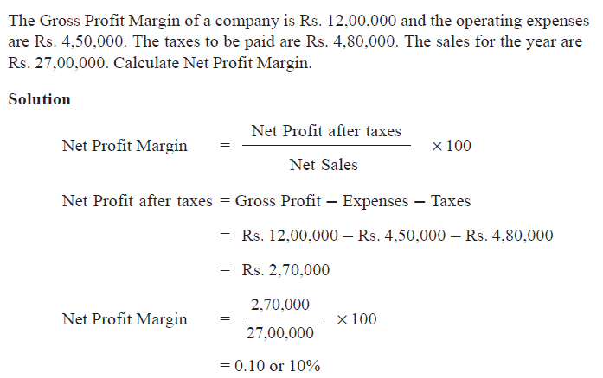
Profitability Ratio

Slide 5
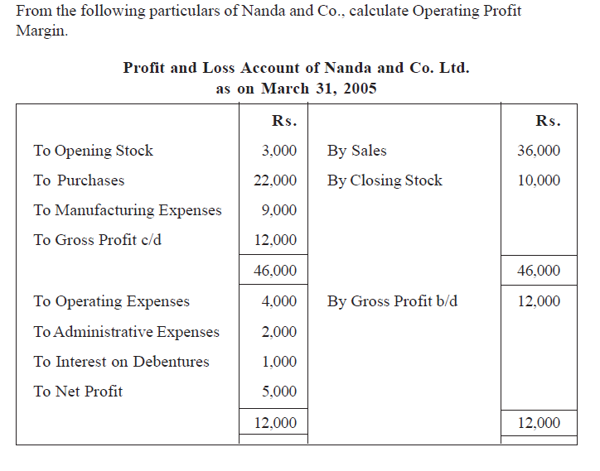

Slide 6
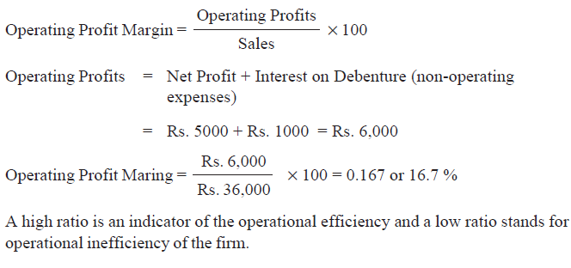
Solution

Slide 7
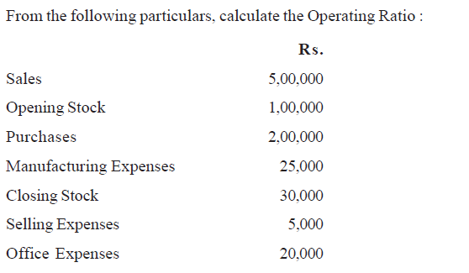
Operating Ratio

Slide 8
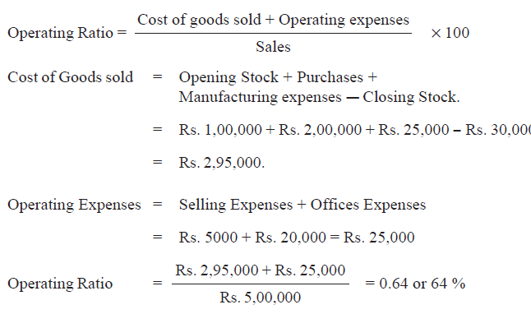
Solution

Slide 9
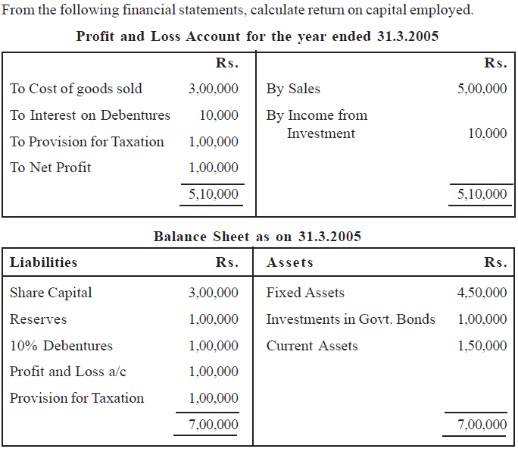

Slide 10
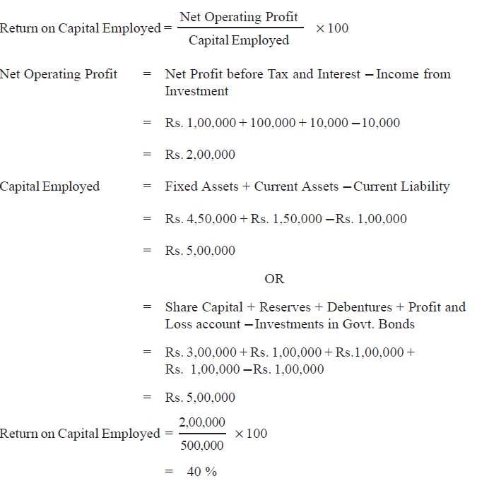

Slide 11
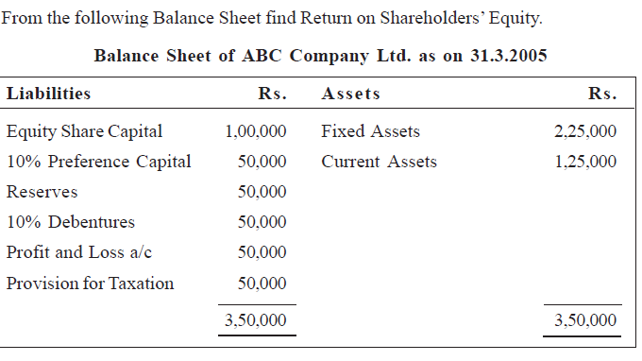

Slide 12
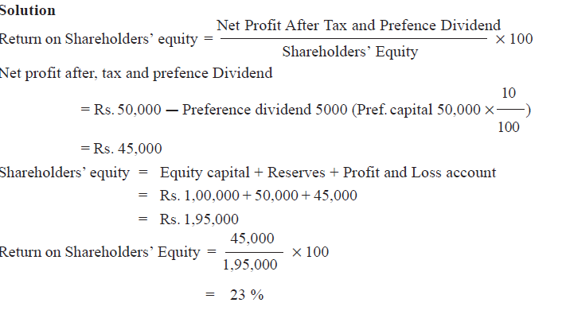

Slide 13
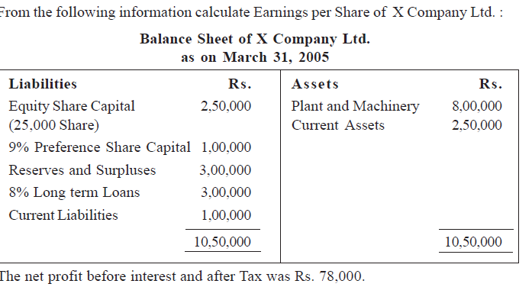

Slide 14
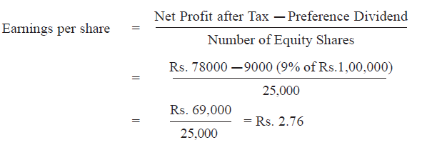

Slide 15
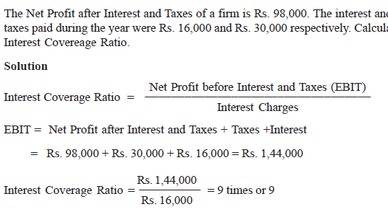

Slide 16
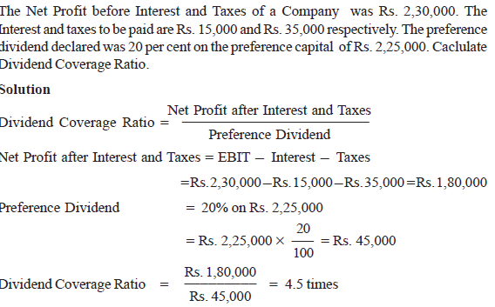

Slide 17
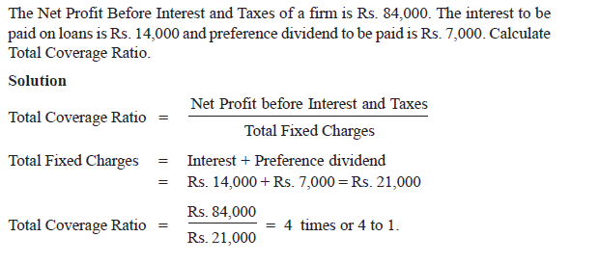

Slide 18
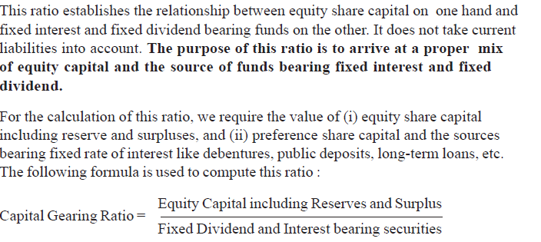
Capital Gearing Ratio

Slide 19
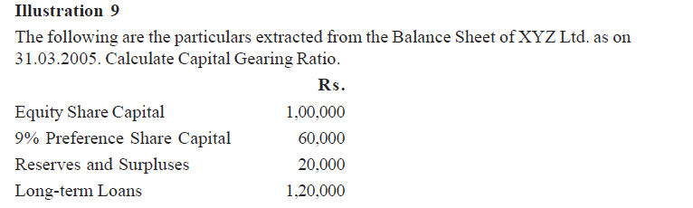
Illustration

Slide 20
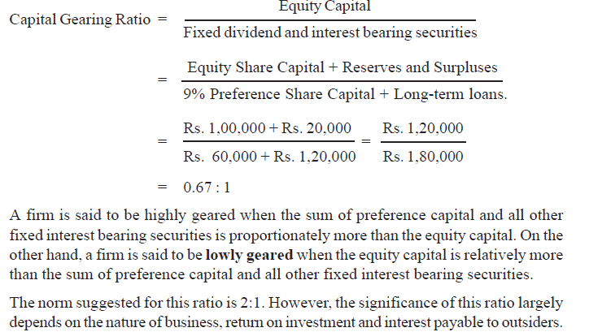

Slide 21
Capital Employed
Shareholders Fund+ LTD = FA (Excluding Fictitious Assets) +Net Current Assets (CA-CL - NWC)

Slide 22
Solvency Ratio
Debt – Equity Ratio = Long term debt/Shareholder’s Fund
LTD includes deb. And long term loans
SF includes equity share capital, pref. share capital and reserve and surplus excluding fic assets

Slide 23
